Slide 1

3D Scene on Street Food Van
Instructed By:
Dr. Sk. Md. Masudul Ahsan
Professor,
Department of CSE, KUET
Md. Badiuzzaman Shuvo
Lecturer,
Department of CSE, KUET
Presented By:
Nushrat Tarmin Meem
Roll: 1907083
Section: B
Year: $4^{th}$
Semester: 2nd
Course No: CSE 4208
Date of Submission: 23/01/25
Khulna University of Engineering & Technology, Khulna-9203
Bangladesh

Slide 2
Contents
Introduction
Objectives
Features
Methodology
Result Analysis
Conclusion

Slide 3
Introduction
A vibrant 3D scene of a street food van highlighting intricate design and realism
Creation of a visually appealing environment
Handling different object shapes, adding variety and complexity
A visual prototype for street food businesses showcases
A planning tool for urban designers to help visualize and organize street food van setups in public spaces

Slide 4
Objectives
Creation of a realistic 3D street food scene
Implementation of texture mapping, lighting, curves, fractals, etc.
Design of diverse object shapes and layouts
Development of a visual prototype for businesses and planners

Slide 5
Features
Different Shaped Objects – Hexagon, Cone, Cylinder, Sphere, Half-Sphere etc.
Lighting (Day and Night)
Shading (Gouraud and Phong)
Texture Mapping
Bezier Curve Generation
Fractals
Simple Dynamic Scene

Slide 6
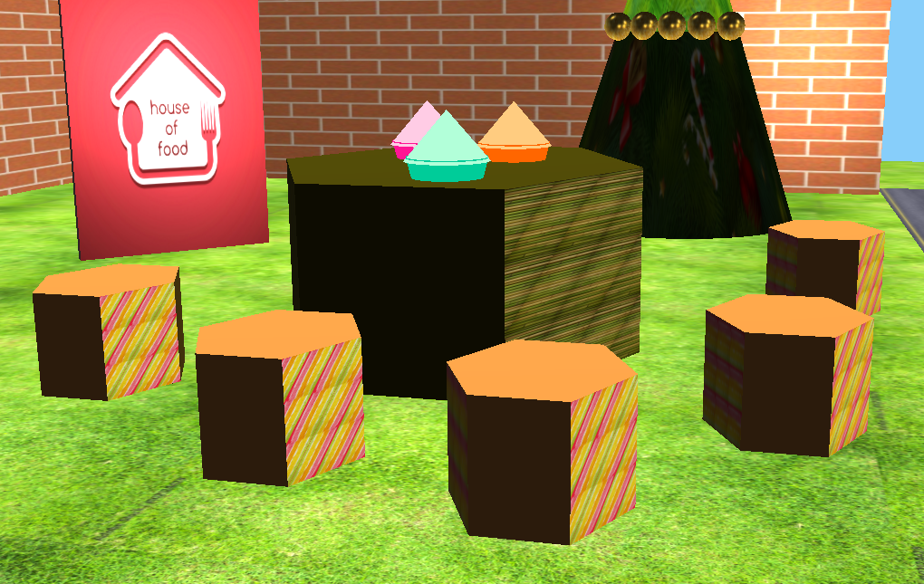
Methodology
Different Shaped Objects: Hexagon
Created by defining vertices and indices to form triangles, then rendering them using glDrawElements(GL_TRIANGLES)
Figure 1: Hexagon Shape

Slide 7
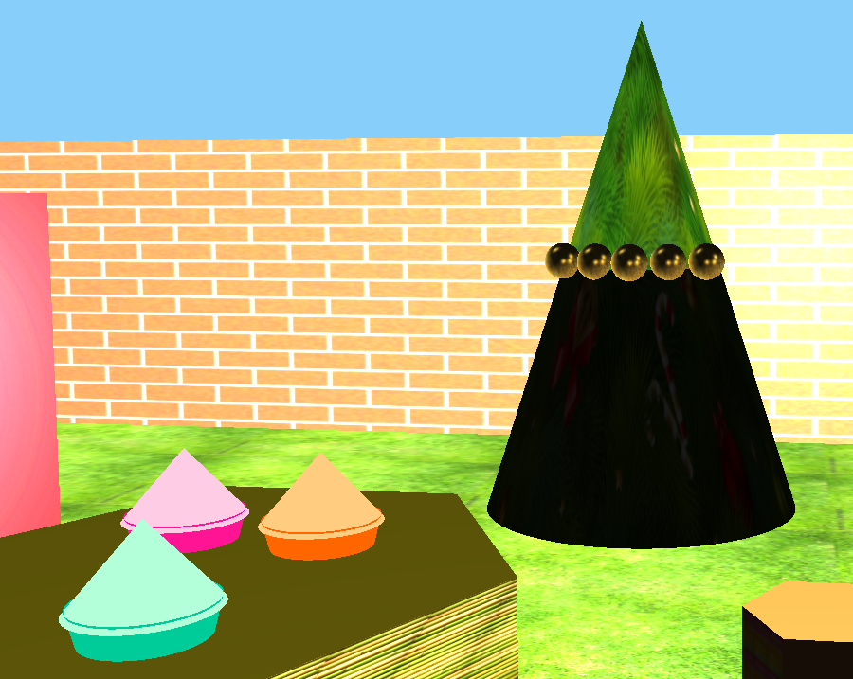
Methodology (contd.)
Different Shaped Objects: Cone
Created by generating vertex coordinates for the base and apex, computing normals, sector-wise defining indices for the base and sides
Figure 2: Cone Shape

Slide 8
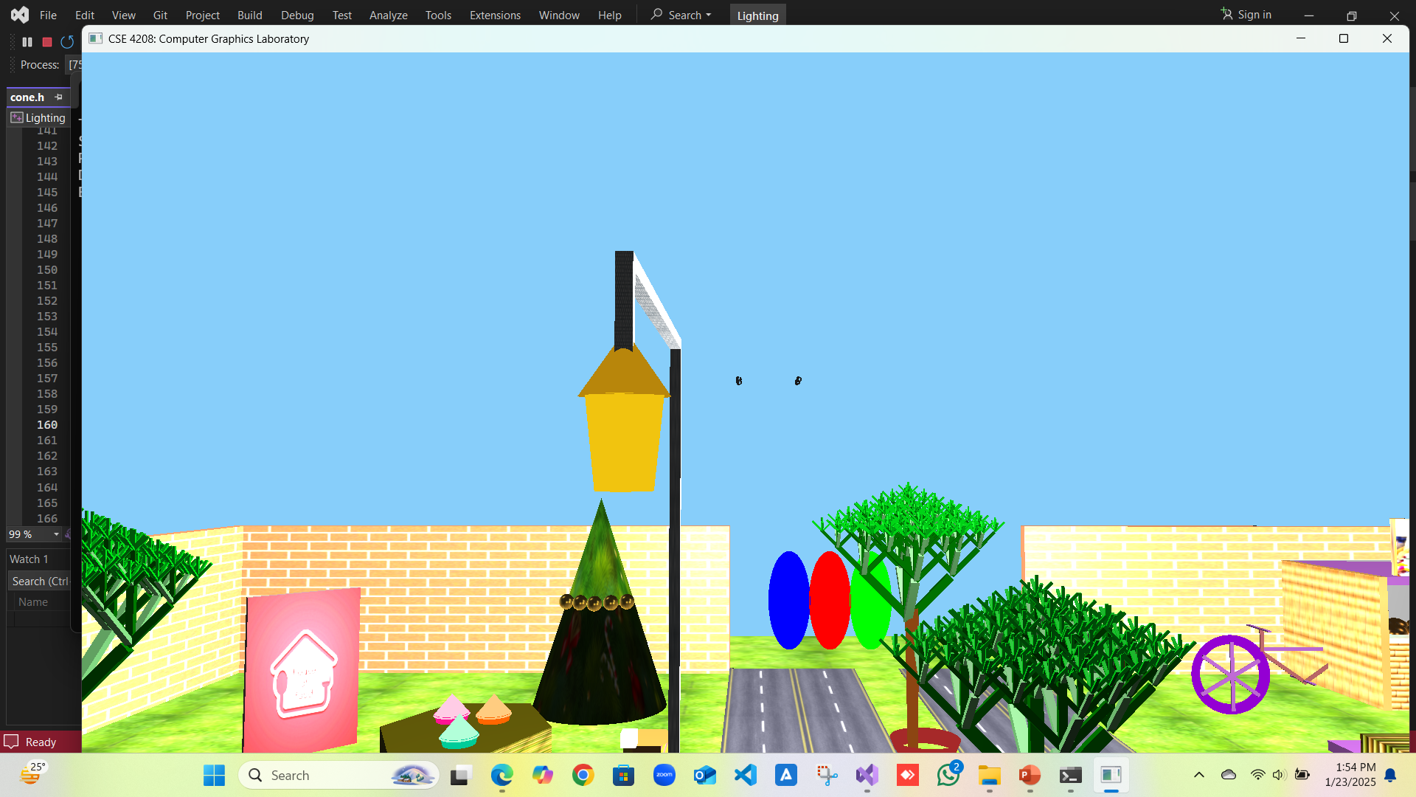
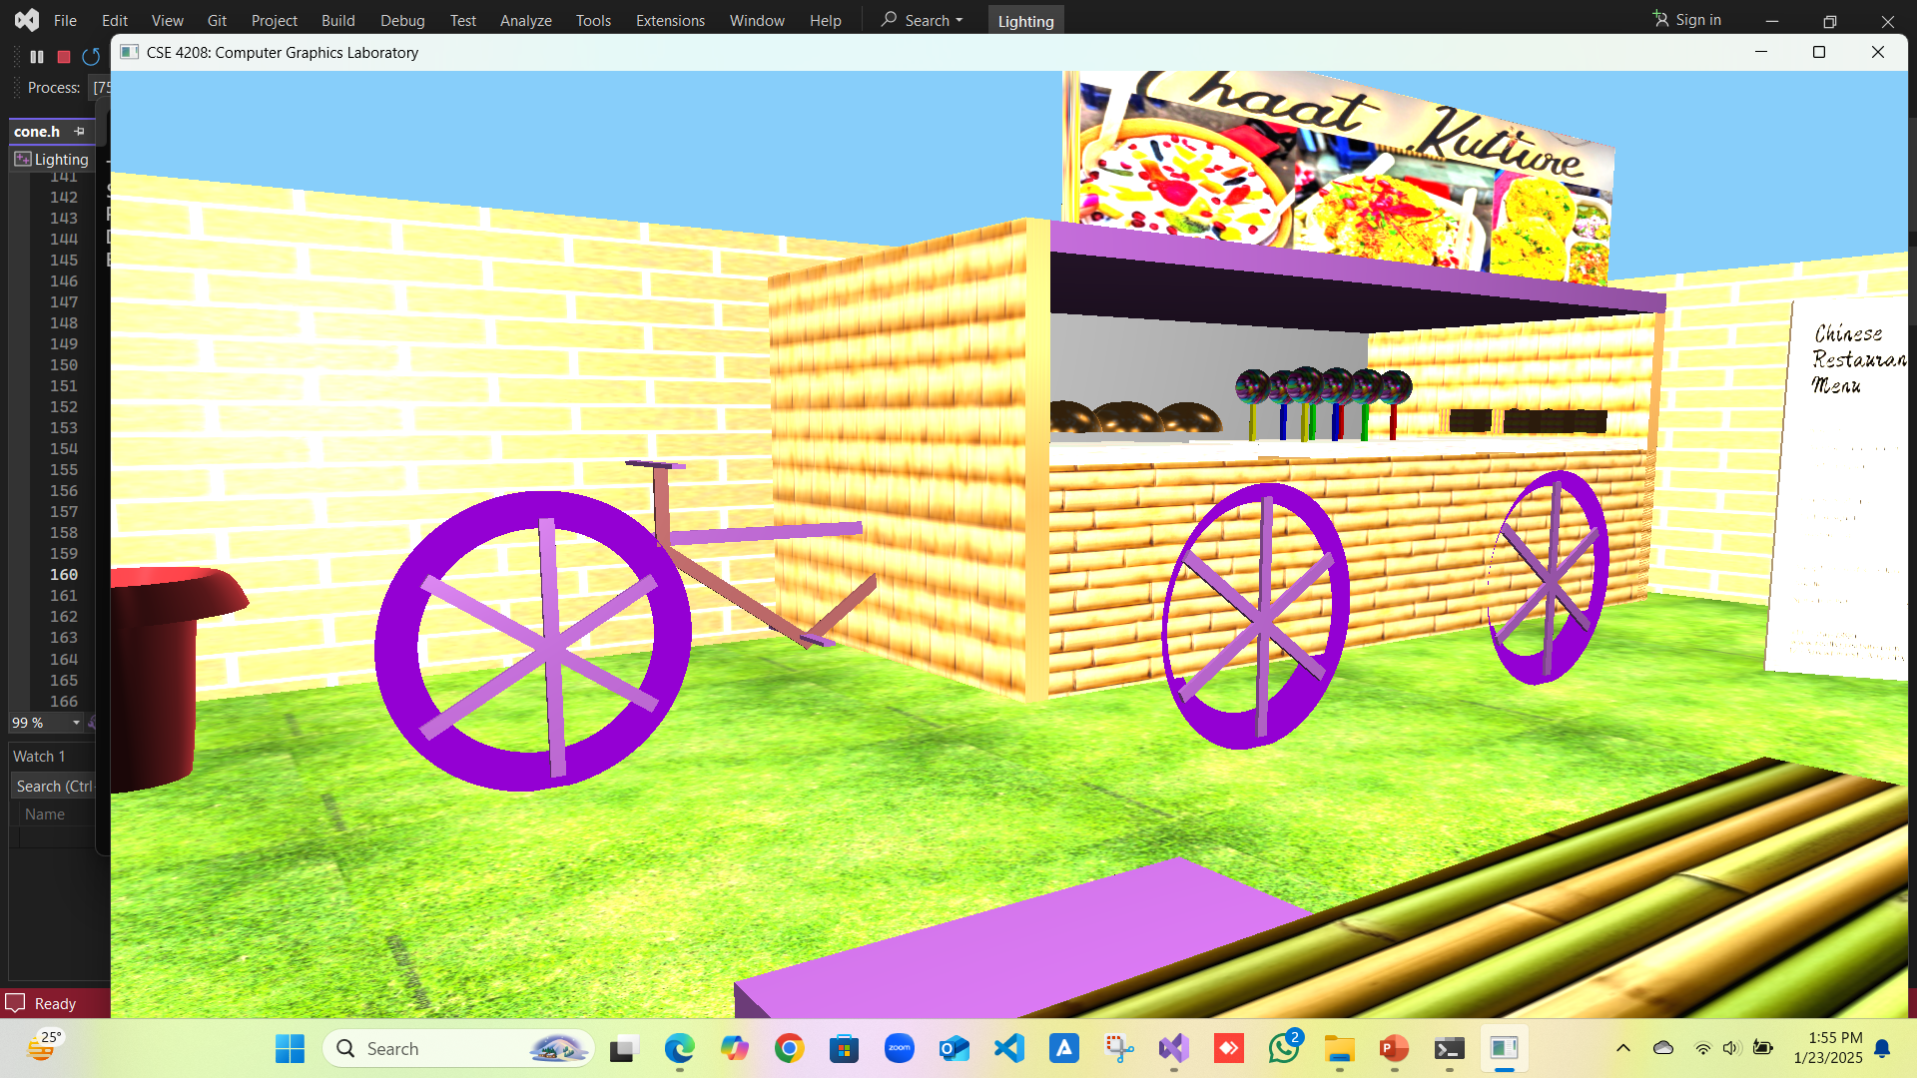
Methodology (contd.)
Different Shaped Objects: Cylinder
Created by using loops and triangles with dynamic radius
Figure 3: Cylinder for a street lamp and wheels

Slide 9
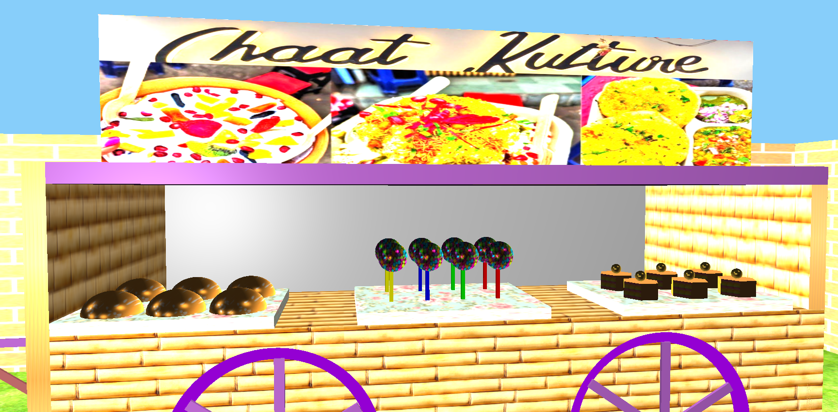
Methodology (contd.)
Different Shaped Objects: Sphere and Half-Sphere
Sphere is created by generating vertices, normals, texture coordinates, and indices based on the specified radius, sector count, and stack count
Figure 4: Sphere for candy and top of cakes whereas half-sphere for bread or bun

Slide 10
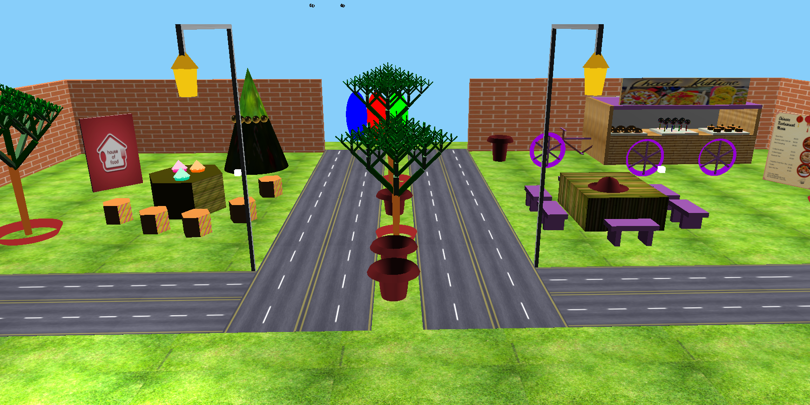
Methodology (contd.)
Lighting and Shading
Point light, Direction light and Spot light created using Phong shading
Figure 5: Spot lights 1 and 3 off (one example shown only)

Slide 11
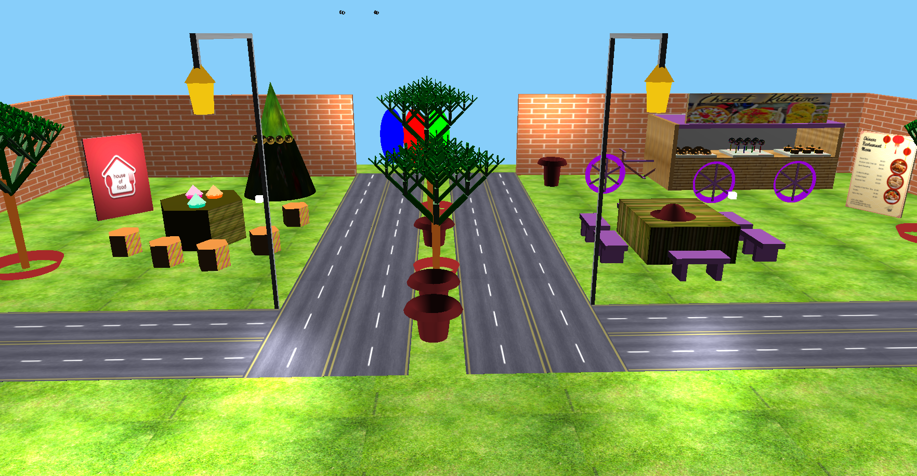
Methodology (contd.)
Lighting and Shading
Point light, Direction light and Spot light created using Phong shading
Figure 6: Spot lights 1 and 3 on (one example shown only)

Slide 12
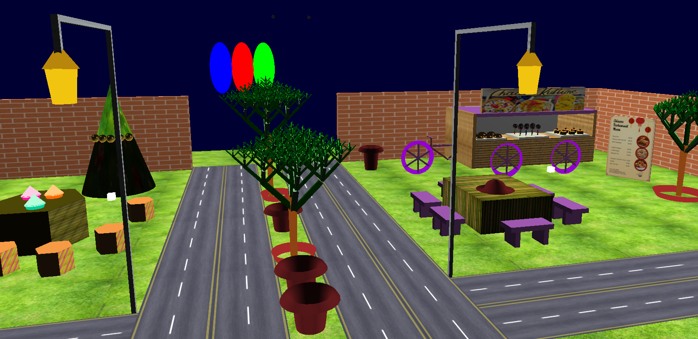
Methodology (contd.)
Lighting and Shading
Night mode on by making sky from light blue to deep blue using glclearcolor()
Figure 7: Night mode on (Key P)

Slide 13
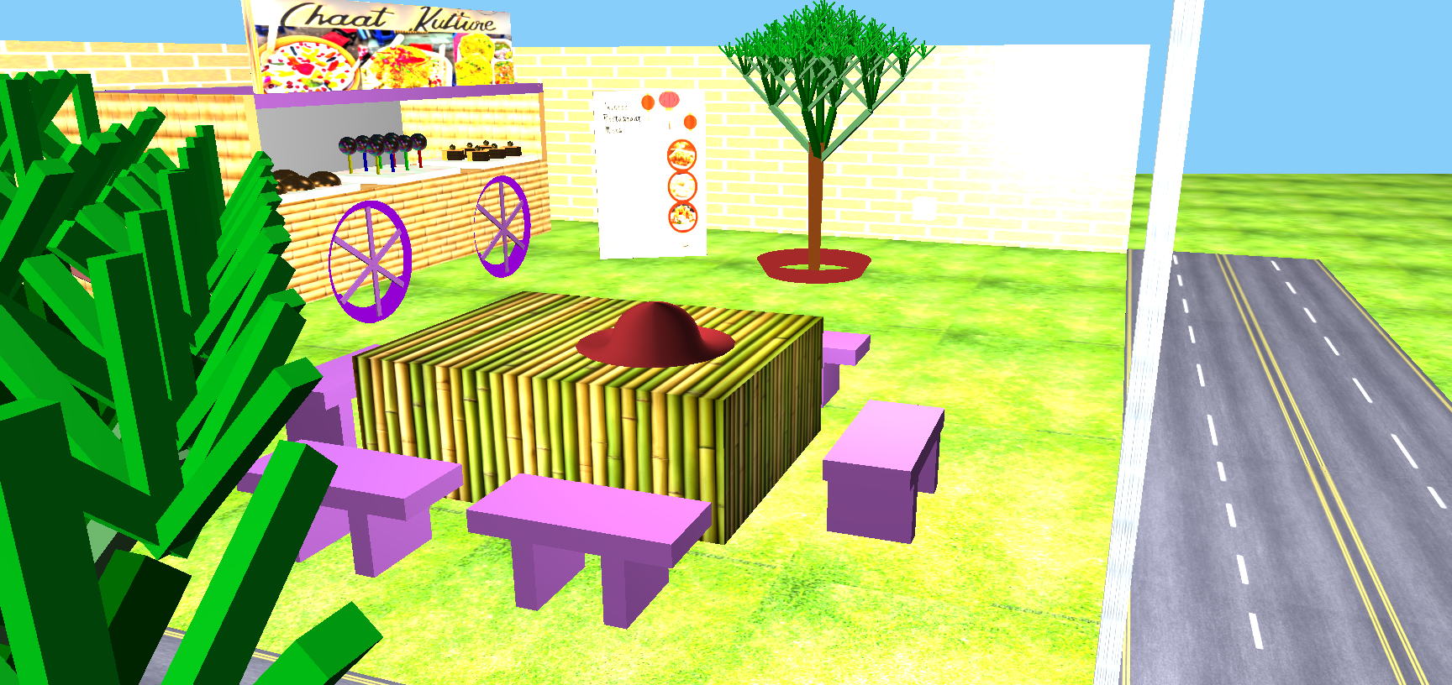
Methodology (contd.)
Bezier Curve Generation and Fractals
Bezier Curve is used to create vases and hat whereas fractals applied to create trees
Figure 8: Curvy object hat and fractal trees

Slide 14
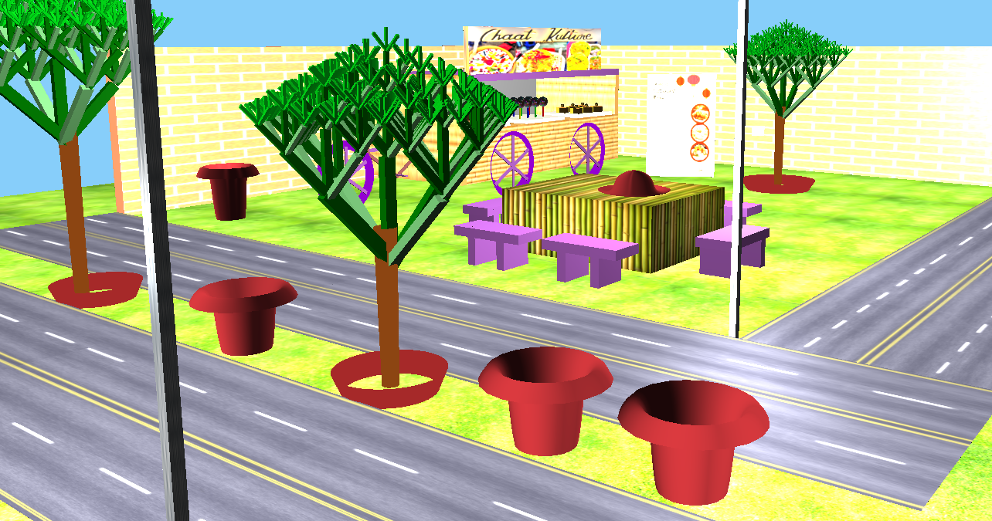
Methodology (contd.)
Bezier Curve Generation and Fractals
Bezier Curve is used to create vases and hat whereas fractals applied to create trees
Figure 9: Curvy object vase and fractal trees

Slide 15
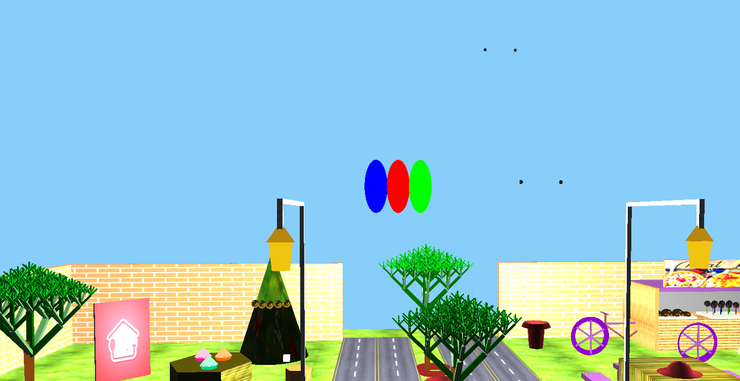
Methodology (contd.)
Simple Animation Added
Based on axis dx, dy, dz is added to flag bit to control movement
Rockets Upward
Movement
Birds Movement
Figure 10: Very Simple Animation

Slide 16
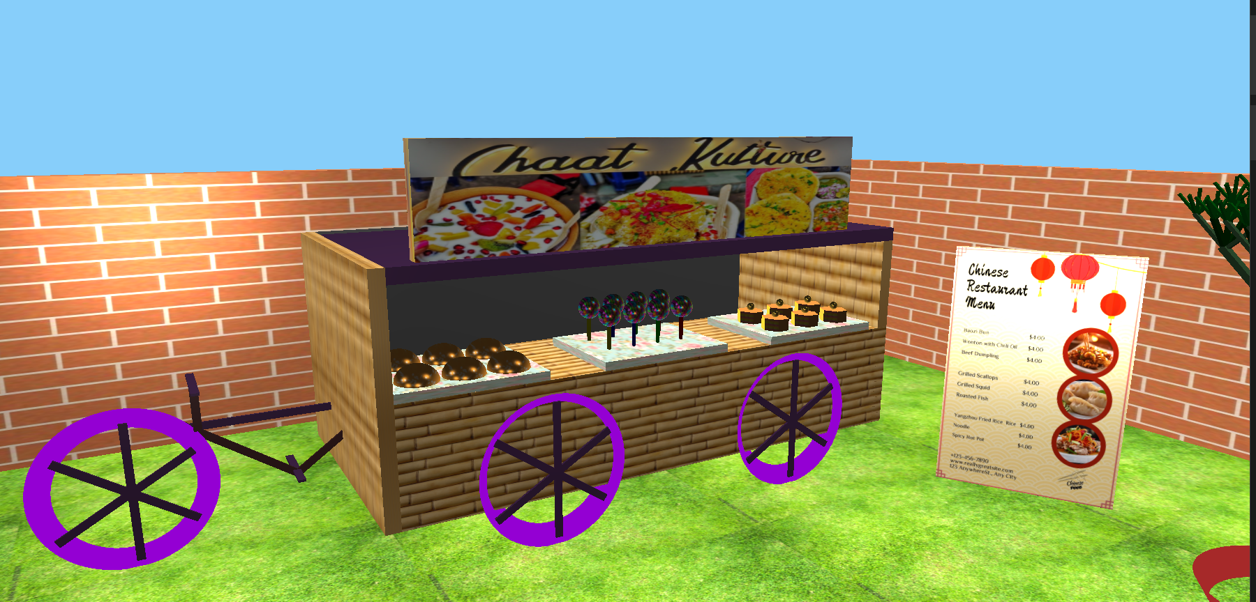
Methodology (contd.)
Main Food Van
Figure 11: Van with food items

Slide 17
Result Analysis
Main Key Functionalities
W – Forward
S – Backward
A – Left
D – Right
R – Up
O – Day Mode
P – Night Mode
3, 4, 7, 8, 9, 0 – Lights Control
X, Y, Z – Rotation
H, I, J – Scaling
Q – Camera
M – Animation

Slide 18
Conclusion
Realistic 3D Environment Creation
Integration of different types of features all together
Can be updated using more dynamic or animated scenes

Slide 19
Thank You

